Slide 1
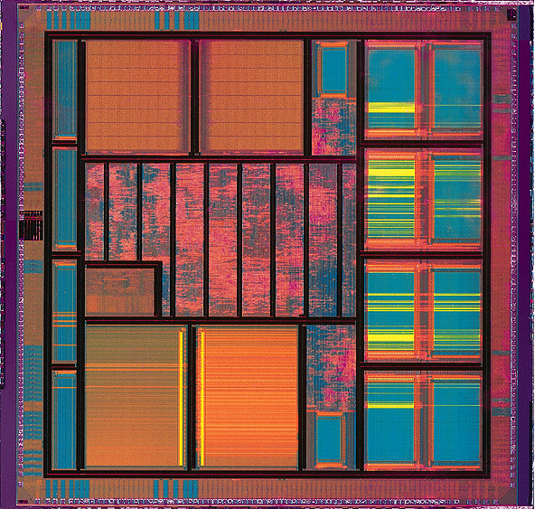
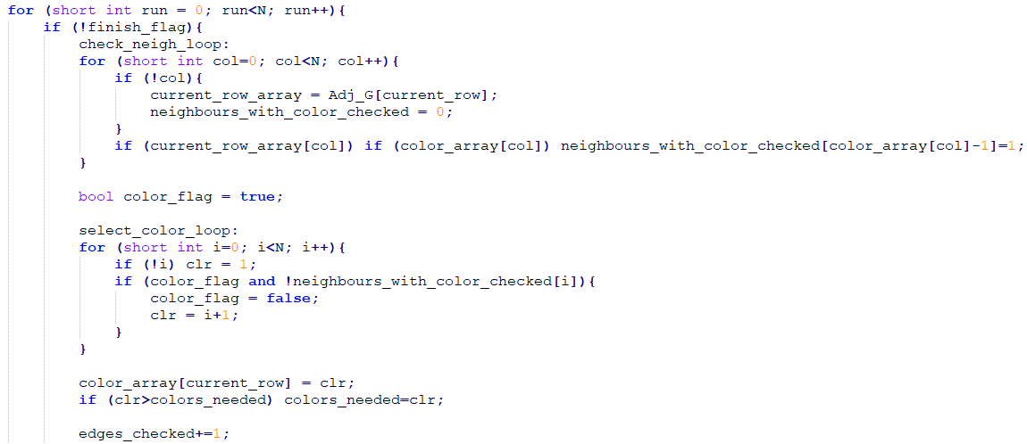
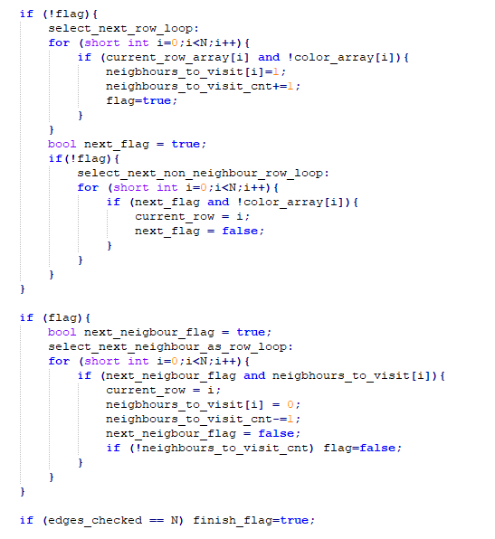
High Level Synthesis Lab
Task E
Check for coloured neighbours
Implemented Algorithm
Step 1: Read neighbours of 1st edge from table (memory) and store it locally.
Step 2: Check each neighbour for having a colour assigned to it. Assign
the lowest colour number not found in any neighbour to current edge. If new colour number was assigned, increase the required graph colours by 1.
Step 3: Having saved each neighbour from step 2, select the first neighbour saved to read as next memory and repeat step 2 until all neighbours from 1st edge are checked. If all neighbours are checked, read the second edge not already checked from memory (if only one is available, read that one). Repeat steps 2 and 3 until all edges have a colour assigned.
Graphs Tested:
Add not-coloured neighbours as next rows
Pick a colour based on neighbours found with colour
If none select next row available to proceed.
+1 for colours needed if new colour picked
Select next neighbour to read

Slide 2
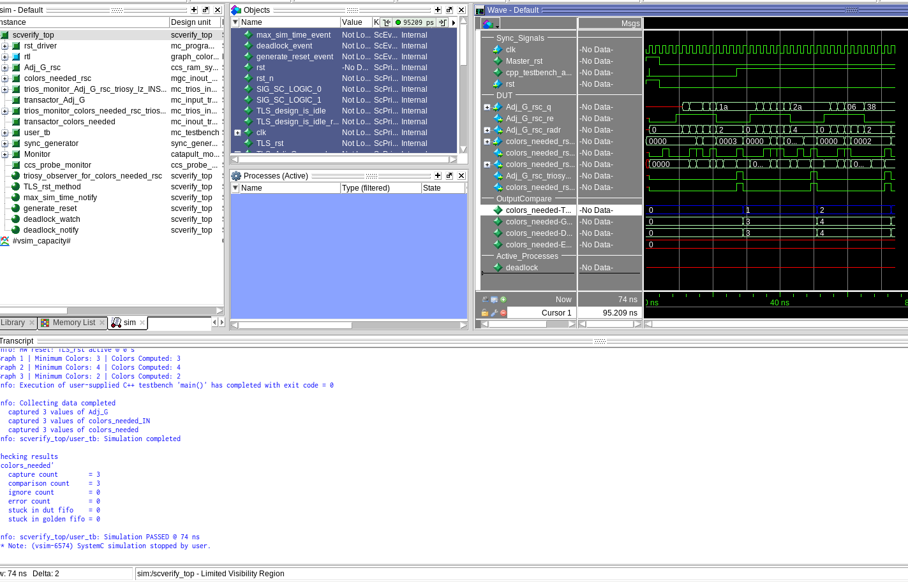
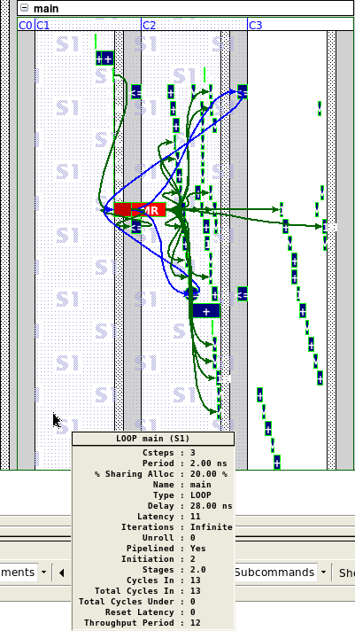
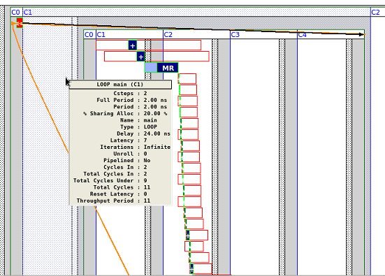
High Level Synthesis Lab
Task E
Pipelined whole module with II=2
Throughput = 11
Pipelined main ‘for’
loop only with II=1
Throughput = 12
Needs 1 more cycle
per graph but has a
‘safer’ slack.

